Slide 1
Select
SLIDE SHOW Mode
for best viewing
Notes:
Most Slides will have an associated reference information
viewable in the NOTES Presentation mode

Slide 2
Health Care A
Campaign For 2026
Today we will Review Ashe County Health Stats and Compare US Health Care With 9 Other Developed Countries
Today let’s Consider Health Care As A Basic Need And Not As A For Profit Product or Commodity
Future Interview and Influence Health Care Providers Goal >50%
Future Present to Ashe County Commissioners >50%
Notes:
https://www.commonwealthfund.org/sites/default/files/2024-09/Blumenthal_mirror_mirror_2024_final_v2.pdf

Slide 3
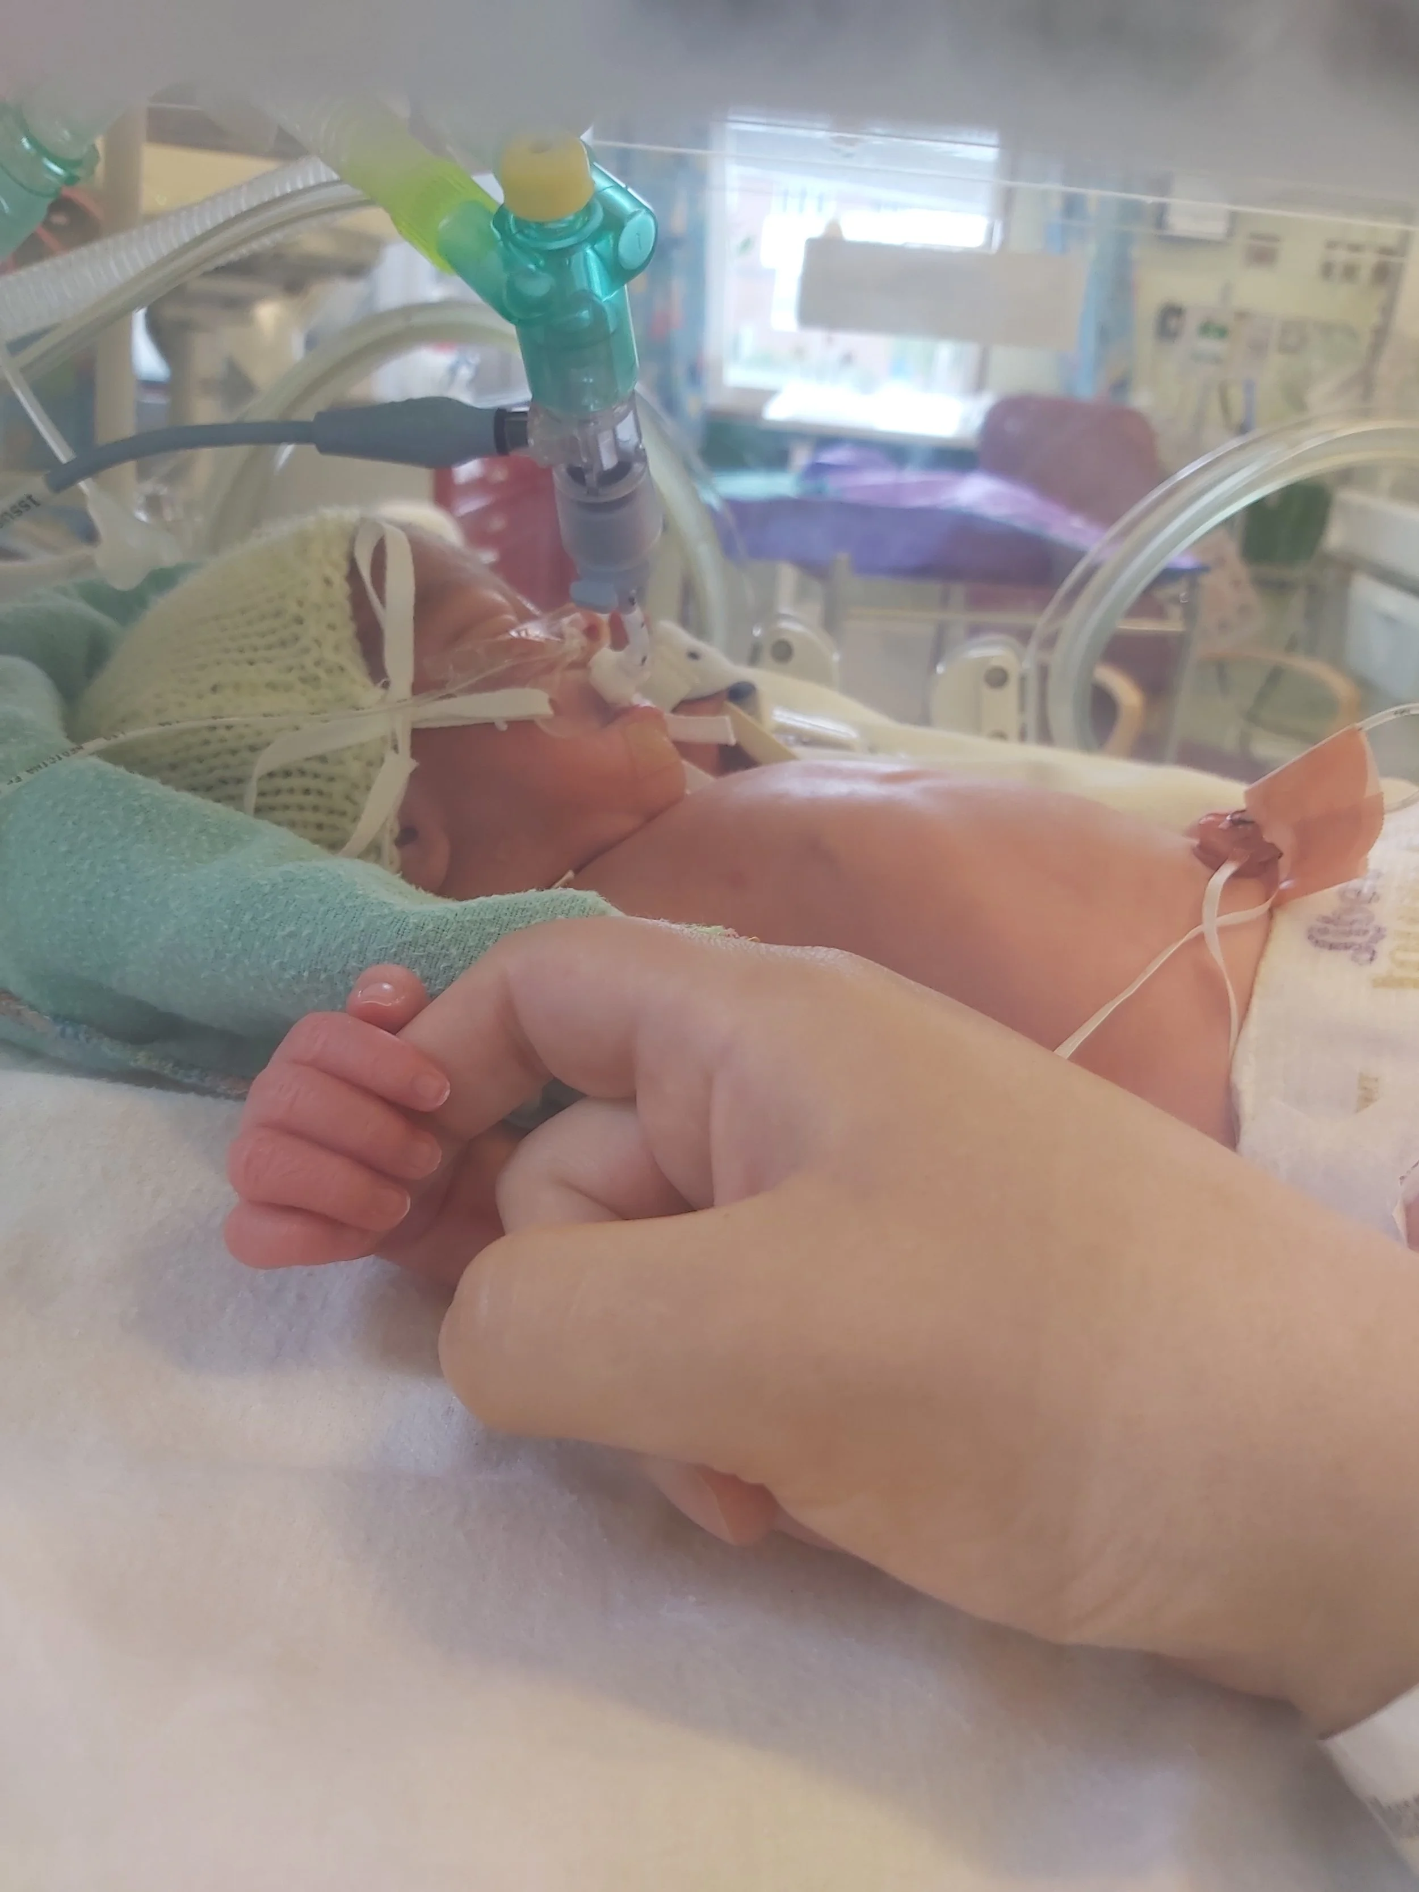




“When people have health care, lives are longer and better.”
First Breath
37% Of All Dollars Spent are for 65 and UP
Last Breath

Slide 4
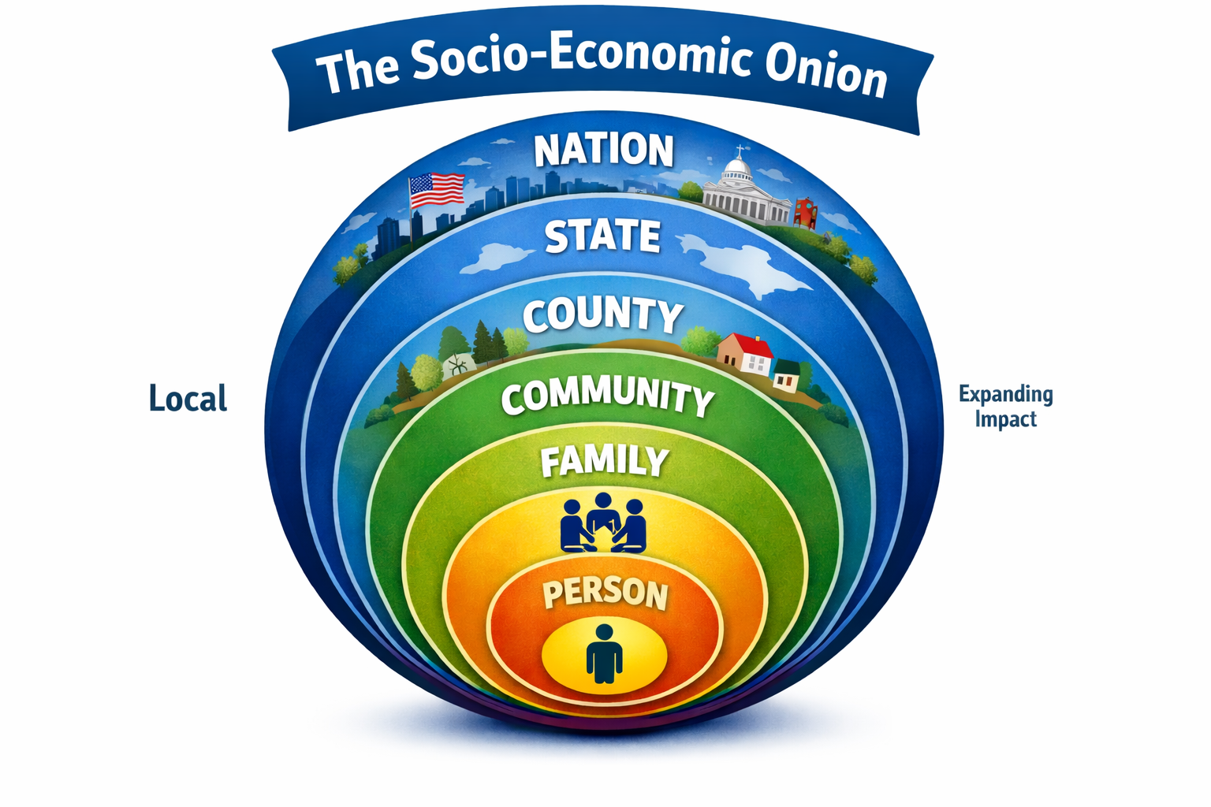
This Applies To Both Health Care And To Legislation Impacting Each Person

Slide 5

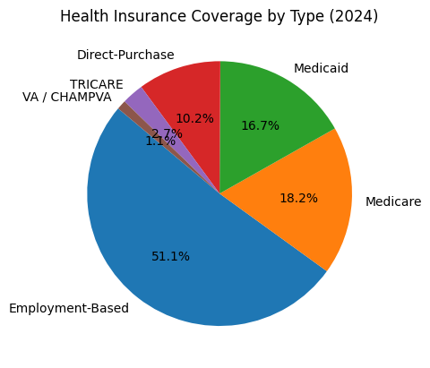
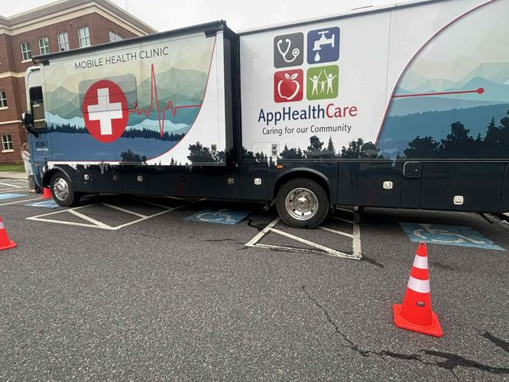
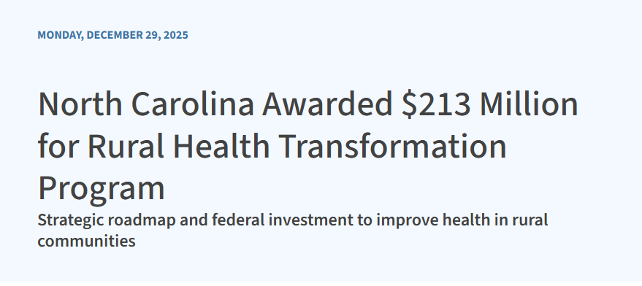

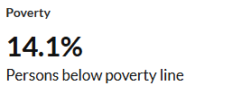
A View Of Ashe County Health Care
The Good
US
+/- 5K Ashe County
+/- 8K Ashe County
Direct Primary Care Model
Elevation Health WJ and New River Wellness Jefferson +$75 Per month
The Bad
18.2% adults age 18 to 64 years are without health insurance +/- 5k
6.5 % of children age 18 and under without health insurance +/- 2K
Notes:
https://home.treasury.gov/system/files/131/People-Enrolled-ACA-Mkt-Coverage-2014-24-09032024.pdf
https://www.worldometers.info/world-population/us-population/
are-mobile-health-clinic-makes-ashe-debut/article_cd03a828-40bf-445b-bbca-7cb449dd9f01.html
https://nciom.org/counties
/ashe-county
348 M 2024 US population
https://https://elevationhealthpc.com/contact/www.ashepostandtimes.com/news/apphealthc
Direct Care Model New River Wellness Jefferson NC and Elevation Health West Jefferson NC

Slide 6










US and 9 Other Countries
Australia
Netherlands
United Kingdom
New Zealand
France
Sweden
Canada
Switzerland
Germany
United States
Access To Care
Care Process
Administrative Efficiency
Equity
Health Outcomes
Notes:
https://www.commonwealthfund.org/publications/fund-reports/2024/sep/mirror-mirror-2024

Slide 7
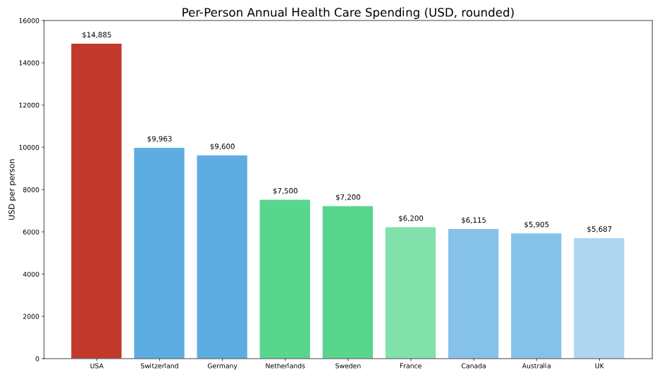

Per Person Annual Health Care Spending
Average $ 7,838
Notes:
https://www.cms.gov/data-research/statistics-trends-and-reports/national-health-expenditure-data/nhe-fact-sheet
https://www.medicaleconomics.com/view/u-s-health-care-spending-hits-4-9-trillion-in-2023

Slide 8



Ethics in Conflict
Private Equity
Patient Focus
VS
Share Holder Responsibility
Notes:
https://www.protectourcare.org/wp-content/uploads/2024/02/greedwatch2023.pdf
https://www.protectourcare.org/wp-content/uploads/2025/12/2025_War-On-Health-Care.pdf
Private equity has been driving up the cost of health care, too, as it buys up practices and then cuts services, raises prices and tries to monopolize specialties. From 2013 to 2022, 82 private equity firms acquired 423 oncology practices, which are necessary to treat cancer.
One study found that practices acquired by private equity firms charged 5.3% more for office visits than the practices that continued under physician ownership. There was a shocking 50% increase in spending on radiation therapy after private equity invaded this field.
The number of physician practices owned by private equity has increased from 816 in 2012 to more than 6,000 today, while private equity owns nearly 488 hospitals. One study in November 2022 by the MIT Sloan School of Management discovered that the negotiated prices between hospitals and insurance companies jumped 32% higher after private equity purchased the hospitals.
https://kenan-flagler.zoom.us/rec/play/o8hx3LfQBtkygjfEaAuQd5tjzgYnTyRxx12ghYrw8LyLkV-wT0PqQW_EldErtuUd4L8vTbTnc060GhQh.ab0axwXDy-ZfFx8o?startTime=1636119749000&_x_zm_rtaid=kcoU7KT1RIWFEeKcCvw5bA.1639424307594.b9bb59f3d7132f06e5e83a3e7b56eec3&_x_zm_rhtaid=381&fbclid=IwY2xjawPYUQBleHRuA2FlbQIxMABicmlkETBLR3dZRkVabkJSamxQamxKc3J0YwZhcHBfaWQQMjIyMDM5MTc4ODIwMDg5MgABHlVhEKedrOYTwoAnQAjaOVugIm4q1-rMsx6KDvIh9RyKaJdZtls7S_ZJ5DKr_aem_ao2O_1kxF2atr14kUbF33Q

Slide 9
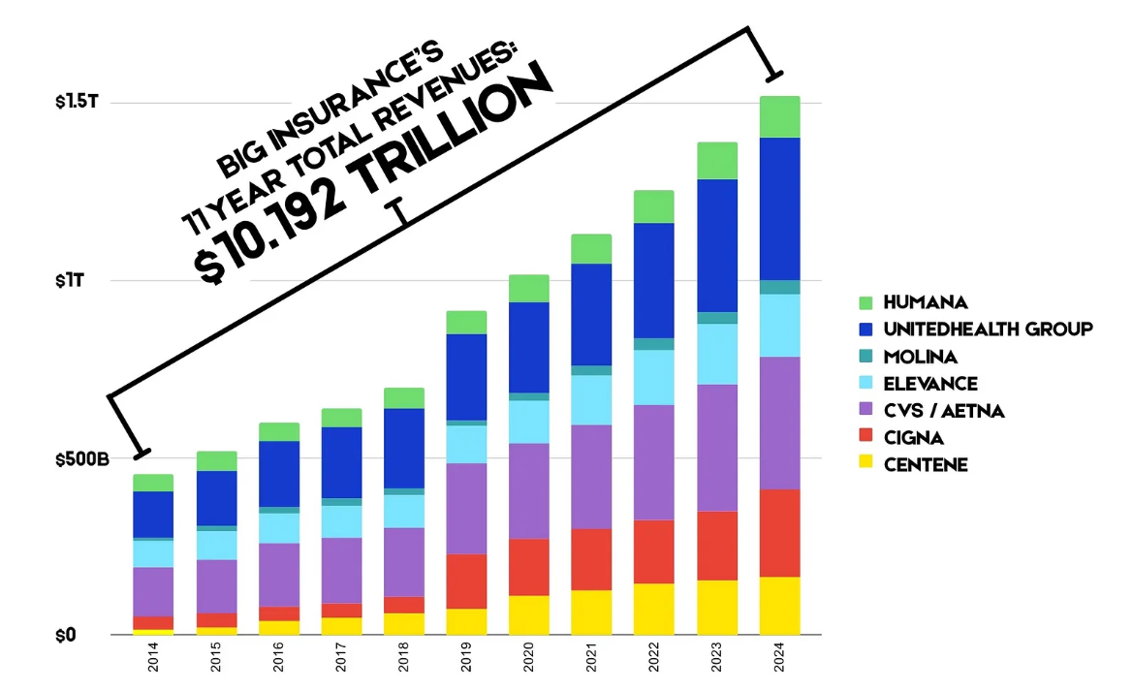
Commercial Ethics Goal
Maximize Profit
$543.4 Billion in Profit
Notes:
https://healthcareuncovered.substack.com/p/the-86-trillion-public-private-partnership
https://www.sunlightreportinsurance.com/
https://healthcareuncovered.substack.com/p/how-big-insurance-got-so-big
https://pestakeholder.org/private-equity-hospital-tracker/#intro

Slide 10

Wait …….What About
Savings From Free Market Efficiencies?
2006 and 2010

Slide 11
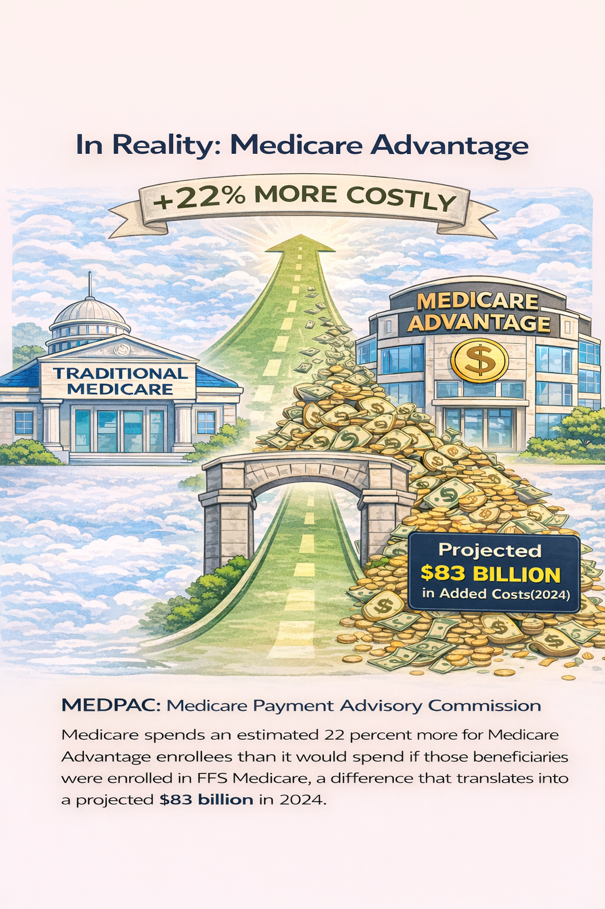
Wait …….What About
Savings From Free Market Efficiencies?
“When You Make Enough Money You Get To Write The Laws”
2006 through 2024
$12 Billion spent in lobbying congress
to keep things just as they are
Notes:
https://schaeffer.usc.edu/research/medicare-advantage-costs-taxpayers-22-more-per-enrollee-heres-how-payment-reform-could-help-close-the-gap/
https://www.medpac.gov/wp-content/uploads/2024/03/Mar24_Ch12_MedPAC_Report_To_Congress_SEC-1.pdf
https://www.youtube.com/watch?v=Ejoi9yfLVCc

Slide 12
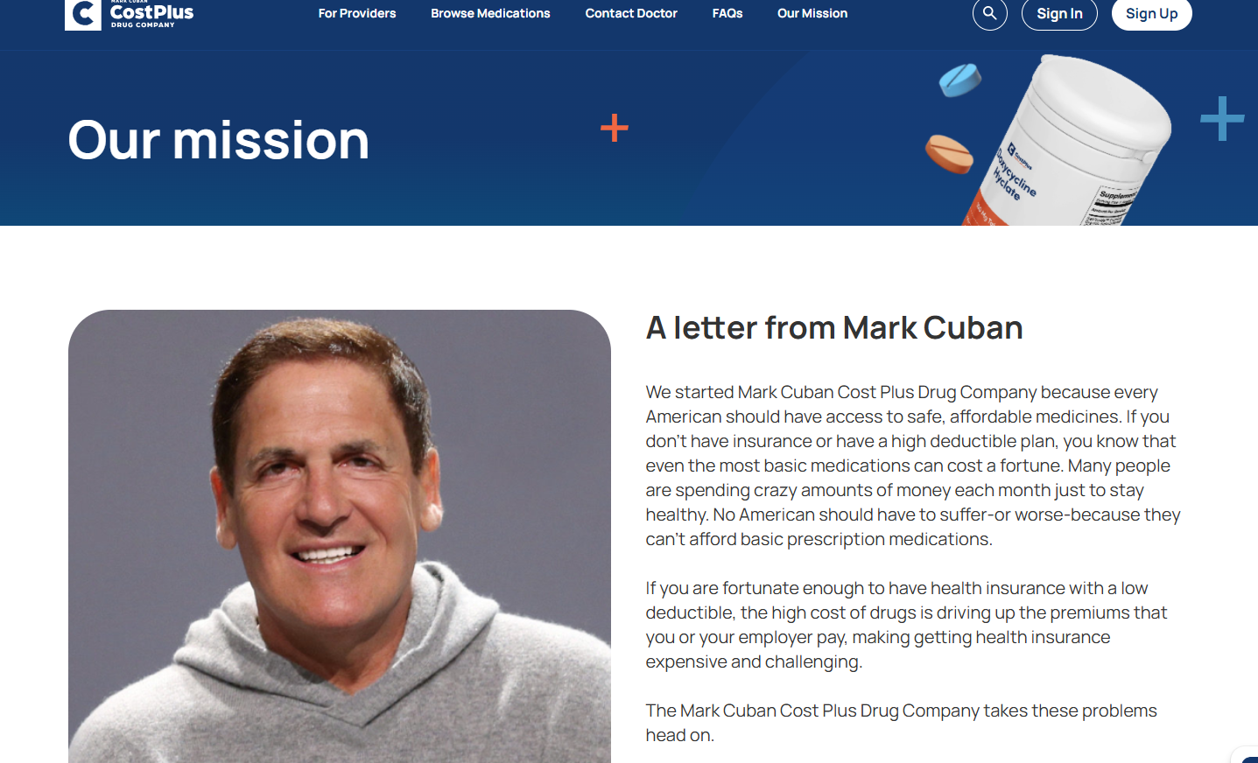
Prescription Drugs
24 cents of every dollar goes to perscription medicine
“Every country except the US limits drug profits through cost-based or negotiated pricing
The U.S. lets prices float freely THANKS TO PBMs (Pharmacy Benefit Managers)— except for Mark Cuban.
www.costplusdrugs.com
Notes:
Learn About Pharmacy Benefit managers:
https://www.youtube.com/watch?v=_khH6pZnHCM
There’s nothing intrinsically wrong with a payment network, but PBMs are much much more profitable than networks running commodities should be. And the reason is that they have become monopolies with the ability to divert revenue that is supposed to travel over their networks to themselves. First let’s take the monopolization - it’s a heavily consolidated space after a spate of acquisitions in the 2000s and 2010s. Three PBMs - Caremark, OptumRx, and Express Scripts - control 80% of the market. It’s a vertically integrated industry; the big three are owned by the biggest insurance companies, CVS, UnitedHealth, and Cigna. It’s also not regulated to prohibit conflicts of interest, the PBMs are allowed to price discriminate among the firms that must use their networks.

Slide 13
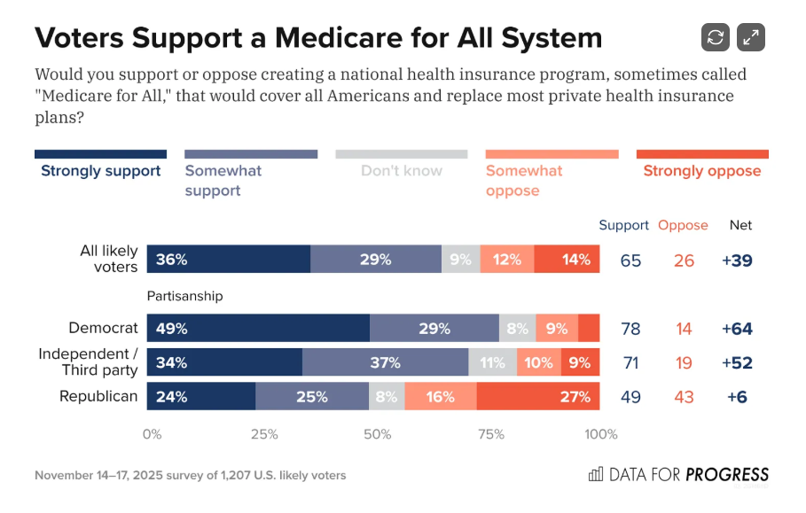
Why DH CAMPAIGN NOW On Health Care?
65 % Support
Notes:
https://www.dataforprogress.org/blog/2025/11/medicare-for-all-is-popular-even-when-put-up-against-attacks
https://www.cbo.gov/system/files/2022-02/57637-Single-Payer-Systems.pdf
https://www.cnn.com/2018/08/04/opinions/medicare-for-all-makes-a-lot-of-sense-sachs/index.html

Slide 14
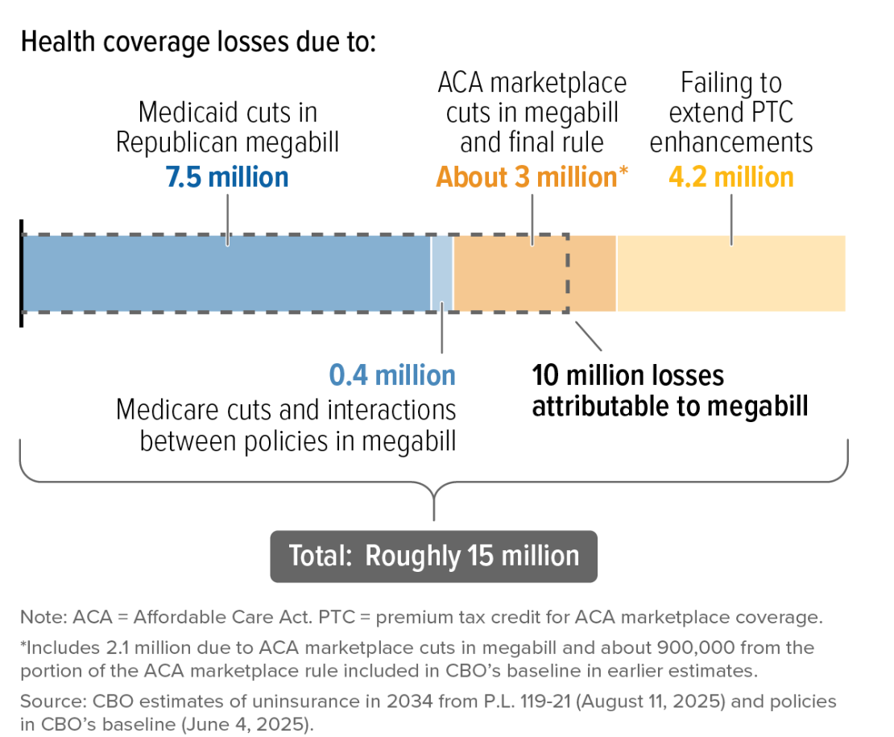
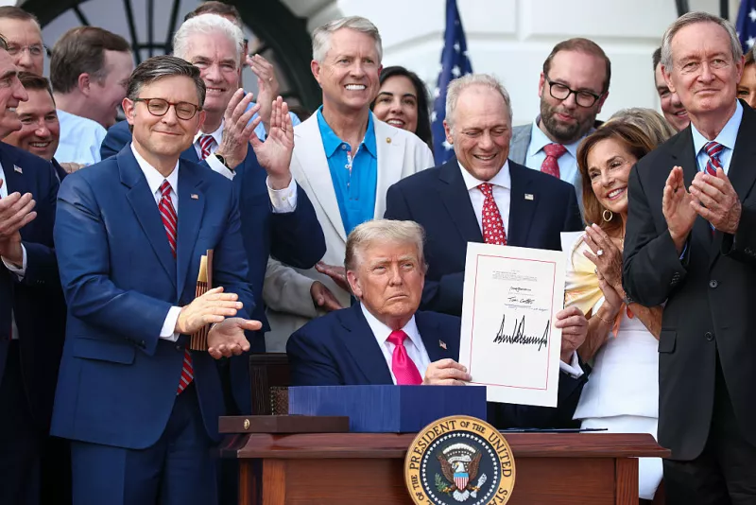
Why Now ?
Significant Lose of Health Care Coverage
Notes:
https://www.dataforprogress.org/blog/2025/11/medicare-for-all-is-popular-even-when-put-up-against-attacks
https://www.cbpp.org/media/roughly-15-million-people-will-lose-coverage-and-become-uninsured-under-republican-health

Slide 15

Why Now?
Ashe County Government Budgets
Ashe County Commission was assessed $367 K in 2025 to offset a projected 2027 Deficit of $947 Million
2,236
Ashe County Employees On the Plan
Notes:
https://hoodline.com/2025/06/north-carolina-state-health-plan-faces-one-billion-dollar-shortfall-by-2027-audit-confirms/
https://spectrumlocalnews.com/nc/charlotte/news/2025/12/09/medicaid-big-beautiful-bill-rural

Slide 16
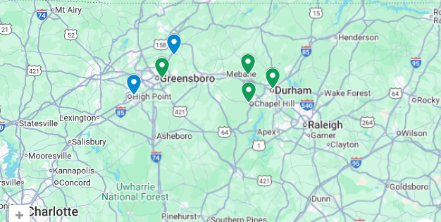

Down Home Campaign
HEALTH CARE 2026
Interview and Influence as many Health Care Stake Holders Q1 through Q2
Town Hall With Stake Holders and Citizens Q3
Q4 Present to Ashe County Commissioners
Ask For Vote On a Resolution for Medicare for All
Notes:
https://www.cbo.gov/system/files/2022-02/57637-Single-Payer-Systems.pdf
https://www.cnn.com/2018/08/04/opinions/medicare-for-all-makes-a-lot-of-sense-sachs/index.html
https://www.medicare4allresolutions.org/is-a-local-resolution-already-underway-in-your-community/

Slide 17


Dr. James Harper
Board Certified Internal Medicine
29 years New York
Relocated to John Creek, GA
Wrote this book in 2025
Notes:
Product details
ASIN ‏ : ‎ B0FFGM1TV8

Slide 18
Other Contributors
Erin Braasch, MPH…..WNC Health Network
Professor Jennifer Tyson PUBLIC Health…..Appalachian State University
Kempton Smith, VP of Finance…..UNC Appalachian Regional Hospital
Rob Hudspeth, President UNC Appalachian Health Care Foundation…..UNC Appalachian Regional Hospital System
Barry Baker, ER Physician (Retired)…..West Palm Beach, Florida
Seth Cooper, Internal Medicine and Oncologist (Retired)…..Nashville, TN
Amanda Gentry Project Manager…..APP Health Care Mobile Clinic Ashe County
Dr. Penelope Copenhaver, DO…..Jefferson, NC

Slide 19
The End
but additional
and Possible Q and A slides follows

Slide 20
Per Person Annual Health Care Spending
4.9 T 17% of GDP
Average $ 7,838
Notes:
https://www.cms.gov/data-research/statistics-trends-and-reports/national-health-expenditure-data/nhe-fact-sheet
https://www.medicaleconomics.com/view/u-s-health-care-spending-hits-4-9-trillion-in-2023

Slide 21
Per Person Annual Health Care Spending
92% Covered
27 M Uninsured
Average $ 7,838
Universal Coverage
Notes:
https://www.cms.gov/data-research/statistics-trends-and-reports/national-health-expenditure-data/nhe-fact-sheet
https://www.medicaleconomics.com/view/u-s-health-care-spending-hits-4-9-trillion-in-2023

Slide 22
Health Care As a DH Campaign For 2026
Today we will Review Ashe County Health Stats and Compare US Health Care With 9 Other Developed Countries
Today let’s Consider Health Care As A Basic Need Not Product Commodity
Future Interview and Influence Health Care Providers
Future Present to Ashe County Commissioners

Slide 23
This Applies To Both Health Care And To Legislation Impacting Each Person

Slide 24




“When people have healthcare, lives are longer and better.”
First Breath
37% Of All Dollars Spent are for 65 and UP
Last Breath

Slide 25
A View Of Ashe County Health Care
The Good
+/- 5K Ashe County
+/- 8K Ashe County
Elevation Health Care Model
The Bad
18.2% adults age 18 to 64 years are without health insurance +/- 5k
6.5 % of children age 18 and under without health insurance +/- 2K
Notes:
https://home.treasury.gov/system/files/131/People-Enrolled-ACA-Mkt-Coverage-2014-24-09032024.pdf
https://www.worldometers.info/world-population/us-population/
are-mobile-health-clinic-makes-ashe-debut/article_cd03a828-40bf-445b-bbca-7cb449dd9f01.html
https://nciom.org/counties
/ashe-county
348 M 2024
https://https://elevationhealthpc.com/contact/www.ashepostandtimes.com/news/apphealthc

Slide 26
US and 9 Other Countries
Australia
Netherlands
United Kingdom
New Zealand
France
Sweden
Canada
Switzerland
Germany
United States
Access To Care
Care Process
Administrative Efficiency
Equity
Health Outcomes
Notes:
https://www.commonwealthfund.org/publications/fund-reports/2024/sep/mirror-mirror-2024

Slide 27
Per Person Annual Health Care Spending
Average $ 7,838
Notes:
https://www.cms.gov/data-research/statistics-trends-and-reports/national-health-expenditure-data/nhe-fact-sheet
https://www.medicaleconomics.com/view/u-s-health-care-spending-hits-4-9-trillion-in-2023

Slide 28
Per Person Annual Health Care Spending
4.9 T 17% of GDP
Average $ 7,838
Notes:
https://www.cms.gov/data-research/statistics-trends-and-reports/national-health-expenditure-data/nhe-fact-sheet
https://www.medicaleconomics.com/view/u-s-health-care-spending-hits-4-9-trillion-in-2023

Slide 29
Per Person Annual Health Care Spending
92% Covered
27 M Uninsured
Average $ 7,838
Universal Coverage
Notes:
https://www.cms.gov/data-research/statistics-trends-and-reports/national-health-expenditure-data/nhe-fact-sheet
https://www.medicaleconomics.com/view/u-s-health-care-spending-hits-4-9-trillion-in-2023

Slide 30

Ethics in Conflict
Notes:
https://www.protectourcare.org/wp-content/uploads/2024/02/greedwatch2023.pdf
https://www.protectourcare.org/wp-content/uploads/2025/12/2025_War-On-Health-Care.pdf

Slide 31
Commercial Ethics Goal
Maximize Profit
$543.4 Billion in Profit
Notes:
https://healthcareuncovered.substack.com/p/the-86-trillion-public-private-partnership
https://www.sunlightreportinsurance.com/
https://healthcareuncovered.substack.com/p/how-big-insurance-got-so-big

Slide 32
Wait …….What About
Savings From Free Market Efficiencies?
2006 and 2010

Slide 33
22 billion in Loffying
Wait …….What About
Savings From Free Market Efficiencies?
2006 through 2024
$12 Billion spent in lobbying congress
to keep things just as they are
Notes:
https://schaeffer.usc.edu/research/medicare-advantage-costs-taxpayers-22-more-per-enrollee-heres-how-payment-reform-could-help-close-the-gap/
https://www.medpac.gov/wp-content/uploads/2024/03/Mar24_Ch12_MedPAC_Report_To_Congress_SEC-1.pdf
https://www.youtube.com/watch?v=Ejoi9yfLVCc

Slide 34
Prescription Drugs
24 cents of every dollar goes to perscription medicine
“Every country except the US limits drug profits through cost-based or negotiated pricing
The U.S. lets prices float freely — except for Mark Cuban.
www.costplusdrugs.com

Slide 35
Why DH CAMPAIGN NOW On Health Care?
65 % Support
Notes:
https://www.dataforprogress.org/blog/2025/11/medicare-for-all-is-popular-even-when-put-up-against-attacks

Slide 36
Why Now ?
Significant Lose of Health Care Coverage
Notes:
https://www.dataforprogress.org/blog/2025/11/medicare-for-all-is-popular-even-when-put-up-against-attacks
https://www.cbpp.org/media/roughly-15-million-people-will-lose-coverage-and-become-uninsured-under-republican-health

Slide 37
Why Now?
Ashe County Government Budgets
Ashe County Commission was assessed $367 K in 2025 to offset a projected 2027 Deficit of $947 Million
2,236
Ashe County Employees On the Plan
Notes:
https://hoodline.com/2025/06/north-carolina-state-health-plan-faces-one-billion-dollar-shortfall-by-2027-audit-confirms/
https://spectrumlocalnews.com/nc/charlotte/news/2025/12/09/medicaid-big-beautiful-bill-rural

Slide 38
Down Home Campaign
HEALTH CARE 2026
Interview and Influence as many Health Care Stake Holders Q1 through Q2
Town Hall With Stake Holders and Citizens Q3
Q4 Present to Ashe County Commissioners
Ask For Vote On a Resolution for Medicare for All
Notes:
https://www.cbo.gov/system/files/2022-02/57637-Single-Payer-Systems.pdf
https://www.cnn.com/2018/08/04/opinions/medicare-for-all-makes-a-lot-of-sense-sachs/index.html

Slide 39
Extra Supporting Slides

Slide 40
Dr. James Harper
Board Certified Internal Medicine
29 years New York
Relocated to John Creek, GA
Wrote this book in 2025

Slide 41
Other Contributors
Erin Braasch, MPH…..WNC Health Network
Professor Jennifer Tyson PUBLIC Health…..Appalachian State University
Kempton Smith, VP of Finance…..UNC Appalachian Regional Hospital
Rob Hudspeth, President UNC Appalachian Health Care Foundation…..UNC Appalachian Regional Hospital System
Barry Baker, ER Physician (Retired)…..West Palm Beach, Florida
Seth Cooper, Internal Medicine and Oncologist (Retired)…..Nashville, TN
Amanda Gentry Project Manager…..APP Health Care Mobile Clinic Ashe County
Dr. Penelope Copenhaver, DO…..Jefferson, NC

Slide 42
Model Outputs (reprice to Medicare +15%, then subtract AI savings, add $6B med school expansion)
Time horizon | AI % Low | AI % Base | AI % High | Spend after repricing (pre-AI) | Net spend (Low) | Net spend (Base)
Current | 1.0% | 1.5% | 2.5% | $4,221,966,205,837.17 | $4,185,746,543,778.80 | $4,164,636,712,749.62
5 years | 3.0% | 4.5% | 6.0% | $4,221,966,205,837.17 | $4,101,307,219,662.06 | $4,037,977,726,574.50
Change to Outcome based model and not current FEE for Service

Slide 43
Medicare For All Should Include
An Opt in Model for any individual or family with $ incentive to OPT IN
Hospitals Operate as not for profit with EXEC Pay Caps and Run by Physicians
Cost Plus Plan for Medications
Outcome Based Pricing model and not the FEE for Service Model
$6 Billion per year to facilitate 10 K New PCP
AI to be Factored into the Savings Model

Slide 44
  1. Clarifying the baseline
The current model does this:
Start with total spend: $4.78T
Reprice services to Medicare Service Pricing +15%
→ $4.22T (before AI)
Apply AI-driven savings (admin, diagnostics, automation)
Add $6B/year for med school expansion
That structure assumes:
Volume of services remains largely intact
Payments still occur per visit / per test / per procedure Fee For Service
AI mainly improves efficiency and accuracy, not utilization behavior
That is enhanced FFS, not outcome-based care.
Explain: Model Outputs (reprice to Medicare +15%, then subtract AI savings, add $6B med school expansion)
1 of 6

Slide 45
2. What changes under an Outcome-Based Pricing model
An outcome-based model (also called value-based care) changes three big things:
    A. Utilization drops (this is the biggest lever)
Because providers are paid for outcomes, not volume:
Fewer redundant tests
Fewer unnecessary specialist referrals
Fewer avoidable admissions
Lower readmissions
Earlier intervention via primary care
Empirical range from CMS, CMMI, OECD pilots:
8–15% utilization reduction over time
(without harming outcomes — often improving them)
    B. Chronic disease costs flatten
Outcome-based care:
Incentivizes prevention
Explain: Model Outputs (reprice to Medicare +15%, then subtract AI savings, add $6B med school expansion)
2 of 6

Slide 46
Rewards long-term disease control (diabetes, CHF, COPD)
Reduces late-stage catastrophic spending
    C. AI multiplies outcome-based effects
AI works better in outcome models because:
It flags risk earlier
It replaces defensive medicine
It supports care-path optimization
  3. Rerun: Outcome-Based Model Savings
Below is a conservative overlay on your existing model.
    Key additional assumptions
Utilization reduction ramps over time
Savings apply after repricing, before AI
AI savings remain as modeled (we don’t double-count)
    Outcome-Based Utilization Reduction Assumptions
Time horizon
Utilization reduction
Current
2%
5 years
6%
10 years
10%
20 years
15%
Applied to: $4.221T post-repricing spend
Explain: Model Outputs (reprice to Medicare +15%, then subtract AI savings, add $6B med school expansion)
3 of 6

Slide 47
    Revised Net Spend — Outcome-Based Model
      CURRENT
Post-repricing: $4.221T
Outcome-based reduction (2%): −$84B
AI base case (1.5%): −$63B
Med school add: +$6B
➡ Net ≈ $4.08T
5 YEARS (Base case)
Outcome-based reduction (6%): −$253B
AI base case (4.5%): −$190B
Med school add: +$6B
➡ Net ≈ $3.77T
Explain: Model Outputs (reprice to Medicare +15%, then subtract AI savings, add $6B med school expansion)
4 of 6

Slide 48
10 YEARS (Base case)
Outcome-based reduction (10%): −$422B
AI base case (7%): −$296B
Med school add: +$6B
➡ Net ≈ $3.51T
      20 YEARS (Base case)
Outcome-based reduction (15%): −$633B
AI base case (10%): −$422B
Med school add: +$6B
➡ Net ≈ $3.17T
4. What this means vs today’s system
    Compared to current ~$4.8T system
Time
Annual savings
Current
~$700B
5 years
~$1.0T
10 years
~$1.3T
20 years
~$1.6T+
This is before secondary benefits like:
Higher labor participation
Lower disability enrollment
Lower uncompensated care
Reduced medical bankruptcy
Explain: Model Outputs (reprice to Medicare +15%, then subtract AI savings, add $6B med school expansion)
5 of 6

Slide 49
Lower uncompensated care
Reduced medical bankruptcy
  5. Why Outcome-Based beats Fee-For-Service (documented)
Fee-for-Service
Pays for volume
Incentivizes overuse
Rewards late intervention
Penalizes prevention
Outcome-Based
Pays for health
Incentivizes prevention
Rewards coordination
Aligns AI, PCPs, and hospitals
Documentation / evidence
CMS CMMI ACO results (2012–2023)
OECD value-based care pilots
VA integrated care system
Kaiser Permanente (partial model)
PLOS Medicine 2020 (admin + utilization reductions)
  Bottom line
The real breakthrough happens when Medicare+15% pricing is paired with outcome-based payment.
That combination:
Preserves provider margins
Caps profiteering
Unlocks AI’s full value
Delivers universal coverage
Saves $1–1.6T per year over time ➡ Net ≈ $3.17T
Explain: Model Outputs (reprice to Medicare +15%, then subtract AI savings, add $6B med school expansion)
6 of 6

Slide 50


Slide 51
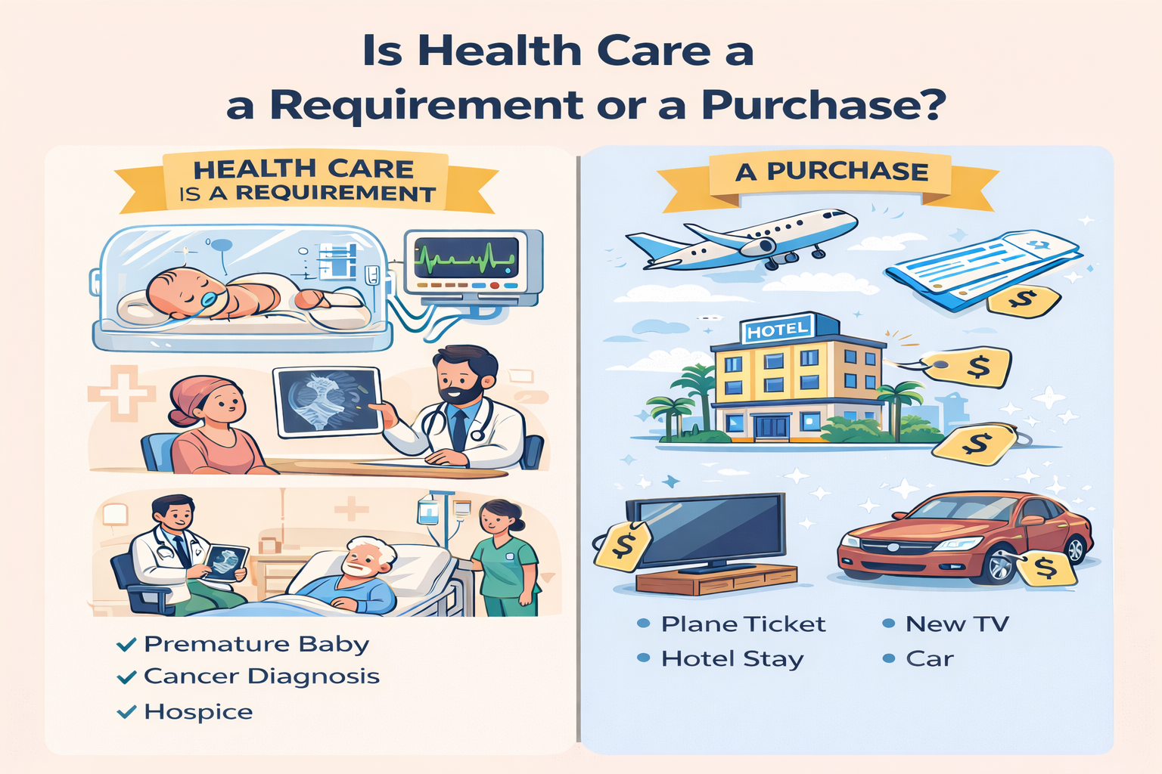

Slide 52
Commercial Ethics LOBBIES $$$$ to
Keep Things As They Are
From 2006 to 2024, the U.S. health care industry spent roughly $12 billion lobbying the federal government—largely to preserve a for-profit, fragmented system while Medicare Advantage expanded and universal or cost-plus alternatives were repeatedly blocked
Notes:
https://schaeffer.usc.edu/research/medicare-advantage-costs-taxpayers-22-more-per-enrollee-heres-how-payment-reform-could-help-close-the-gap/
https://www.medpac.gov/wp-content/uploads/2024/03/Mar24_Ch12_MedPAC_Report_To_Congress_SEC-1.pdf
https://www.youtube.com/watch?v=Ejoi9yfLVCc

Slide 53
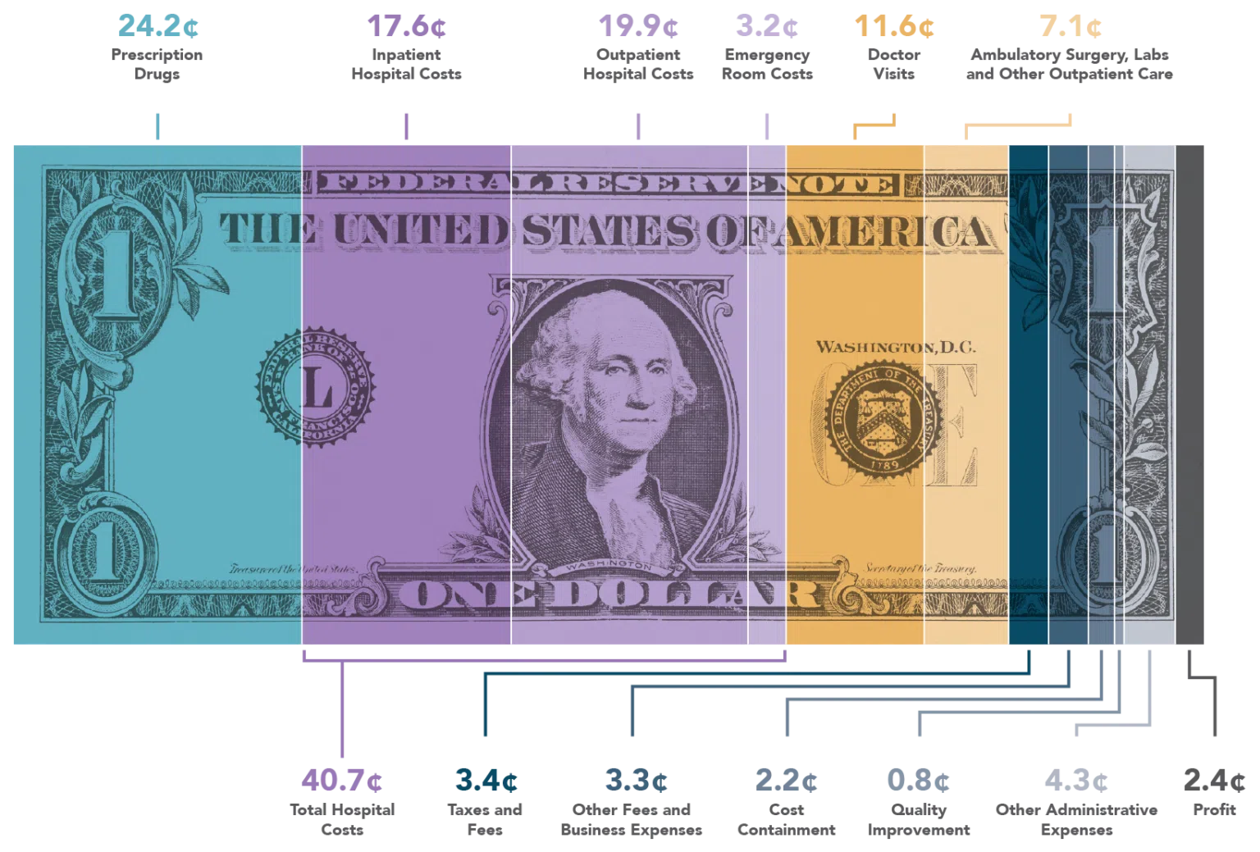
Perscription Drugs
Notes:
https://razormetrics.com/2024/12/06/healthcare-dollar-breakdown/

Slide 54

ACA premiums Increase 26% in 2026
Plus Subsidies Eliminated
Why Now? The Double Whammy Factor
Notes:
https://healthcareuncovered.substack.com/p/the-double-whammy-behind-the-2026
https://healthcareuncovered.substack.com/p/family-health-premiums-just-hit-27000
https://www.thirdway.org/memo/the-republican-health-care-price-hike.pdf

Slide 55
Why Now?
Health Care Economist Savings Can Be Realized
What the Evidence Shows About Single-Payer Health Care
22 independent cost analyses—from across the political spectrum—
found that single-payer would reduce overall health spending while covering all U.S. residents.
From simplified billing
Administration
Negotiated drug prices
Replacing private insurers with a public system.
Notes:
PLOS Medicine | https://doi.org/10.1371/journal.pmed.1003013 January 15, 2020

Slide 56
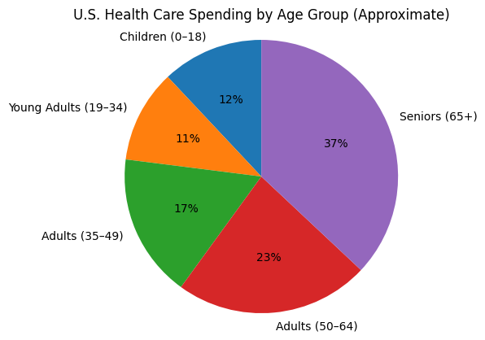
Notes:
https://www.advisory.com/daily-briefing/2023/02/02/healthcare-spending

Slide 57
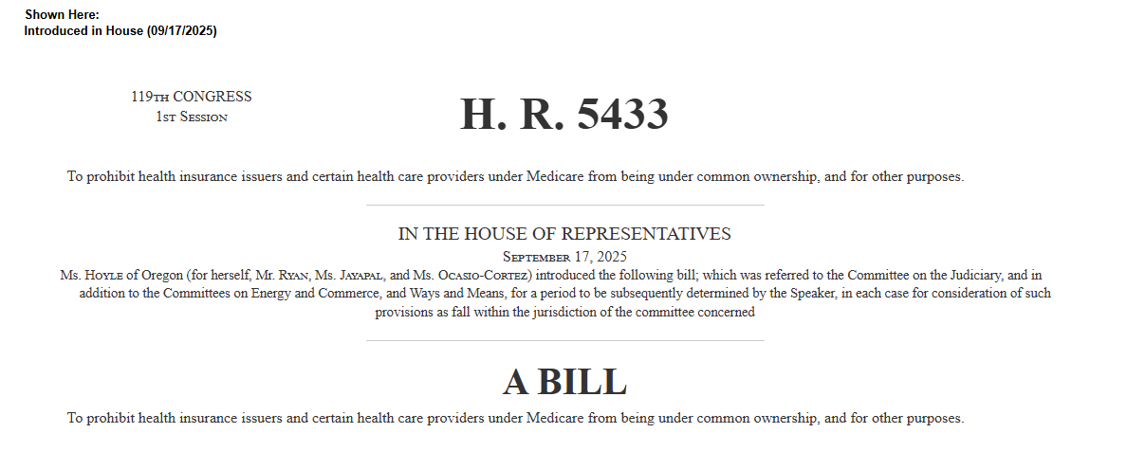
Timing # 4 Pending Legislation
‘Patients Over Profit Act’’ or the ‘‘POP Act’’.
Notes:
https://www.congress.gov/bill/119th-congress/house-bill/5433/text

Slide 58

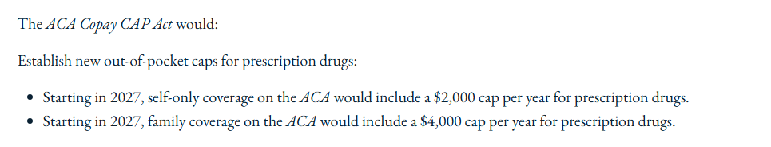
Timing # 4 Pending Legislation
Notes:
https://www.congress.gov/bill/119th-congress/house-bill/6171/text

Slide 59
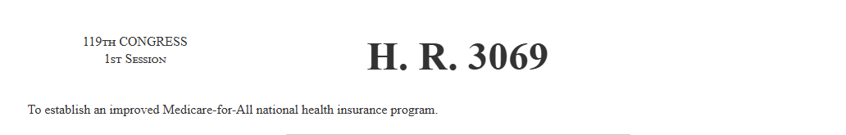
Timing # 4 Pending Legislation
Medicare For All
This bill establishes a national health insurance program that is administered by the Department of Health and Human Services (HHS).
Among other requirements, the program must (1) cover all U.S. residents; (2) provide for automatic enrollment of individuals upon birth or residency in the United States; and (3) cover items and services that are medically necessary or appropriate to maintain health
The bill prohibits cost-sharing (e.g., deductibles, coinsurance, and copayments) and other charges for covered services.
.
Notes:
https://www.congress.gov/bill/119th-congress/house-bill/3069/text
https://www.youtube.com/watch?v=ASPdsS2qgjQ
https://newrepublic.com/article/202572/obamacare-aca-subsidies-joe-lieberman-killed-public-option
https://www.ucsf.edu/news/2020/01/416416/single-payer-systems-likely-save-money-us-analysis-finds
Health insurance exchanges and specified federal health programs terminate upon program implementation. However, the program does not affect coverage provided through the Department of Veterans Affairs or the Indian Health Service.
The bill also establishes a series of implementing provisions relating to (1) health care provider participation; (2) HHS administration; and (3) payments and costs, including the requirement that HHS negotiate prices for prescription drugs.
Individuals who are age 18 or younger, age 55 or older, or already enrolled in Medicare may enroll in the program starting one year after enactment of this bill; other individuals may buy into the program at this time. The program must be fully implemented two years after enactment

Slide 60
Launching locally governed “NC ROOTS” hubs to connect medical, mental health and social supports
Expanding prevention, chronic disease management, maternal health, and nutrition programs
Increasing access to mental health services, including substance use disorder treatment
Investing in the rural health care workforce
Supporting more rural providers in transitioning to value-based care models, where providers are paid based on keeping people healthy and out of the hospital rather than on how many services are provided
Enhancing technology in health care through artificial intelligence and expanded broadband access
Notes:
https://governor.nc.gov/news/press-releases/2025/12/29/north-carolina-awarded-213-million-rural-health-transformation-program

Slide 61
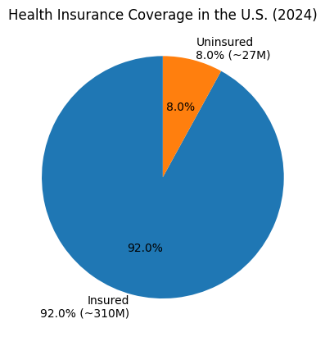
92.0%

Slide 62
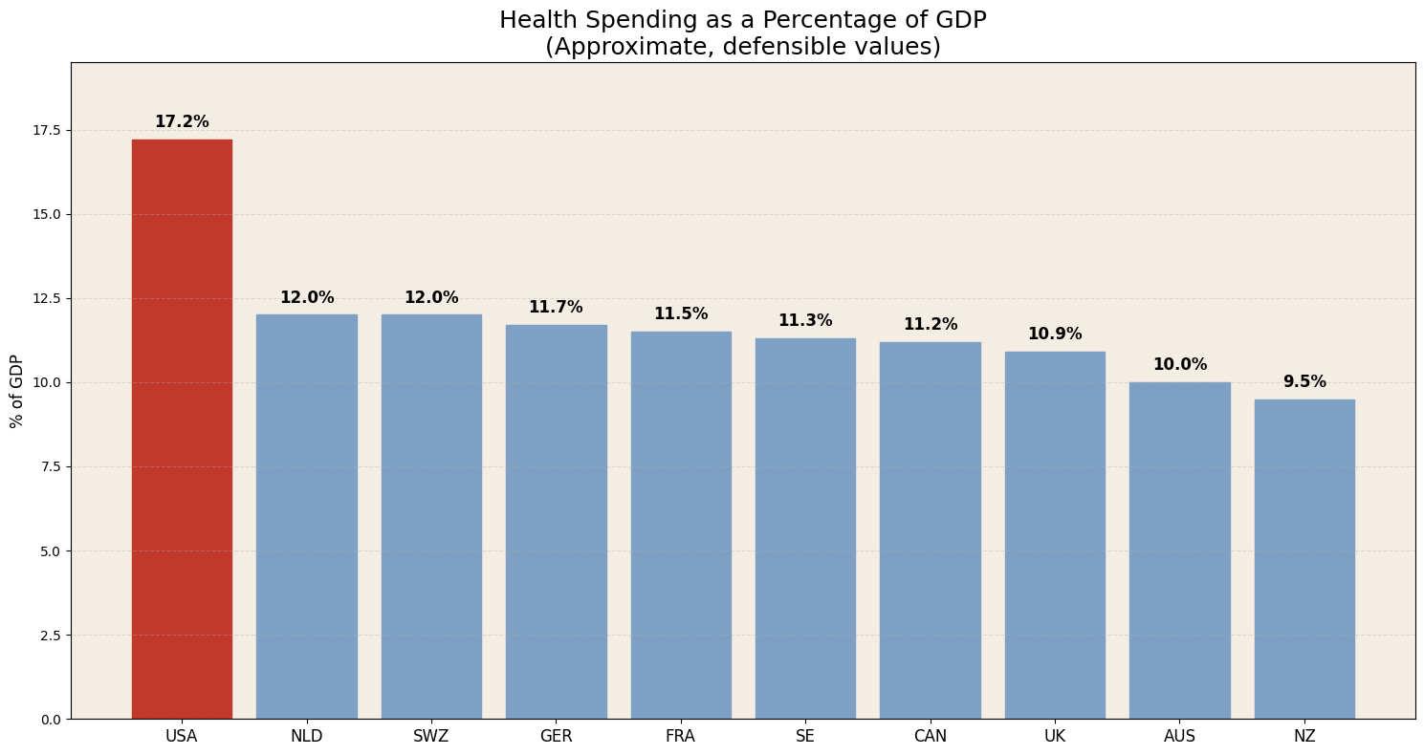
$4.6T $135B $105B $500B $500 B $70 B $350 B $330B $220 B $30 B
Notes:
https://www.commonwealthfund.org/publications/fund-reports/2024/sep/mirror-mirror-2024

Slide 63
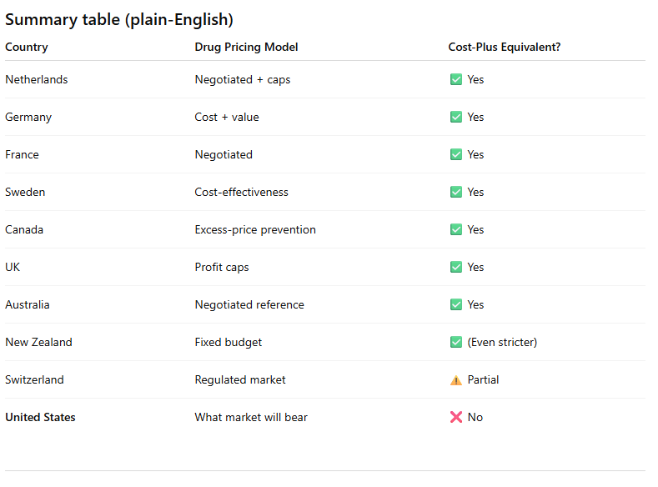
Perscription Drugs
“Every high-income country limits drug profits through cost-based or negotiated pricing.
The U.S. lets prices float freely — except for Mark Cuban.”

Slide 64
$4.6T $135B $105B $500B $500 B $70 B $350 B $330B $220 B $30 B
Notes:
https://www.commonwealthfund.org/publications/fund-reports/2024/sep/mirror-mirror-2024

Slide 65
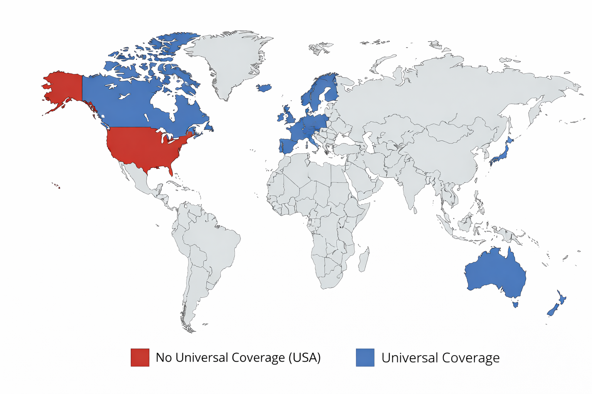
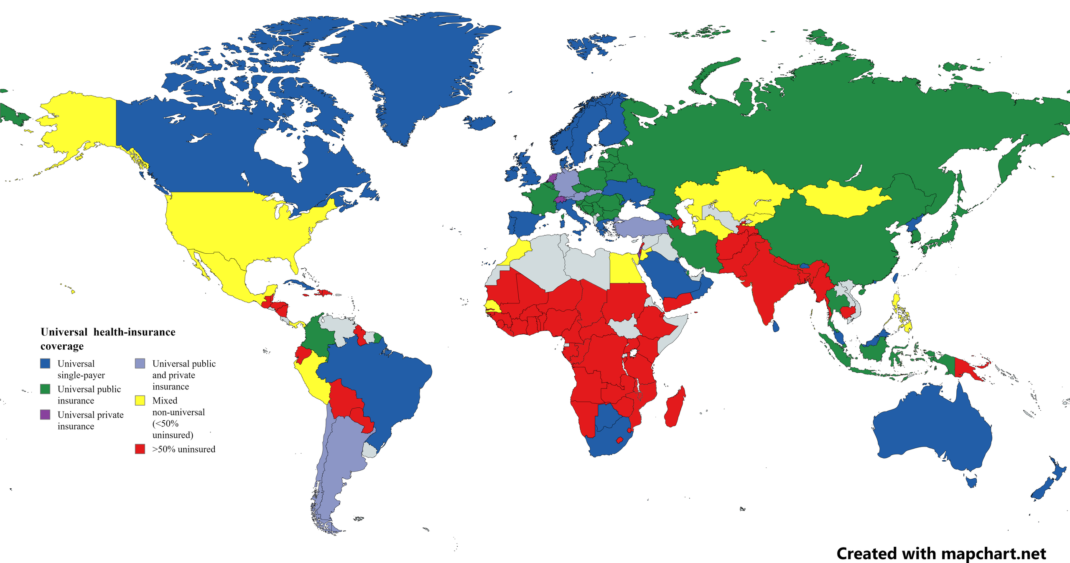
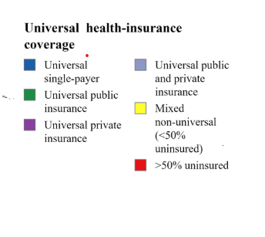
TOP 10 VERSUS ALL
Notes:
https://en.wikipedia.org/wiki/Universal_health_care_by_country
https://cdn.who.int/media/docs/default-source/gho-documents/gmr-2025_conference-edition_online.pdf?sfvrsn=f8cf10f6_9&download=true

